Slide 1
Machine Learning: Fourier Analysis
Presented by: Derek Kane

Slide 2
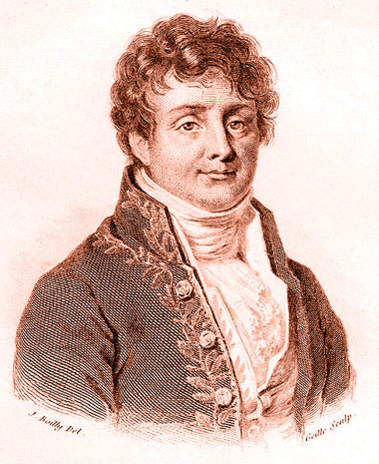
Overview of Topics
Introduction to Fourier Analysis
Fourier Transform
Time Series Modeling
Practical Application Example
Supply Chain Management
Joseph Fourier – French Mathematician and physicist born in 1768 for whom the Fourier transform and Fourier’s Law were named after. Fourier is also generally credited with the discovery of the greenhouse effect.

Slide 3
Introduction to Fourier Analysis
Fourier analysis is a mathematical method used to break down and transform a periodic function — i.e., a mathematical relationship between a quantity and a variable or variables whose relative values consistently repeat over some regular period of time — into a set of simpler functions which can then be summed and transformed back into the original form. Invented in the early 19th century, French physicist and mathematician Jean Baptiste Joseph Fourier transformed the partial differentiation equation representing the propagation of heat into a series of simpler trigonometric wave functions — i.e., sines and cosines — that could be superimposed to reconstitute the original function, thereby providing a simpler, general solution to the problem.
Today, Fourier analysis is used to analyze and better understand a wide range of natural and man-made processes and phenomena. It has been applied to a wider variety of problems in the physical and natural sciences and in engineering, including quantum mechanics, acoustics, electrical engineering, image and signal processing, neurology, optics, and oceanography.

Slide 4
Introduction to Fourier Analysis
A Fourier analysis begins with a Fourier transform, which breaks down, or decomposes, a single, more complicated periodic wave function into a set of simpler elements called a Fourier series that takes the form of sine and cosine waves or complex exponential equations. These can then be solved using simpler mathematics and superimposed, or recombined, to yield a solution to the original function via linear combination. Narrowly defined, Fourier analysis refers to the process of decomposing the original function into a series of simpler components. More generally, it can also include Fourier synthesis, the process by which the original function is reconstituted by performing an inverse transform that essentially runs the Fourier analysis in reverse.
Improved, expanded upon, and the core of what has come to be known as the field of harmonic analysis, Fourier analysis has evolved and progressed to include the study of more abstract and general phenomena. Fourier analysis is now used actively, regularly, and widely in econometrics and financial markets theory by researchers and practitioners to forecast, as well as analyze and better understand, the nature and behavior of a wide range of time series data and parameters that exhibit non-linear relationships and repeating, wave-like patterns over time. Among its many applications, it has been used to model long-term economic cycles, the relationship between inflation and the demand for money, and patterns and trends in the stock, foreign exchange, and housing markets, and cycles in the semiconductor industry, as well as to measure the efficiency of a national economy.

Slide 5
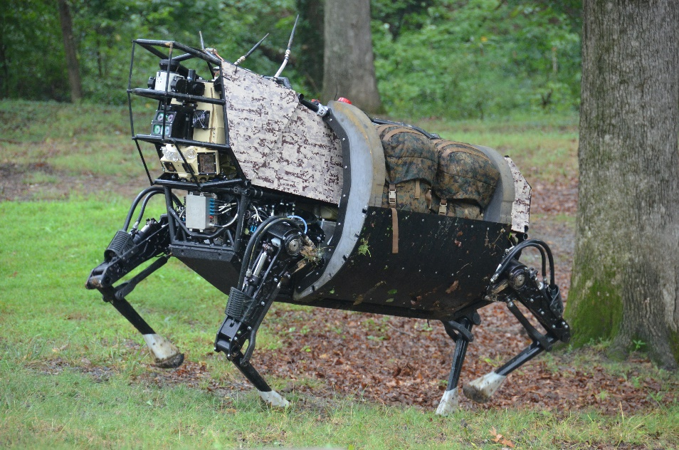
Fourier Analysis Applications
Bio-inspired computing takes a more evolutionary approach to learning.
In traditional AI, the intelligence is often programmed from above. The Programmer creates the program and imbues it with its intelligence.
Bio-inspired computing, on the other hand, takes a more bottom-up, decentralized approach.
Bio-inspired computing often involve the method of specifying a set of simple rules, a set of simple organisms which adhere to those rules.
DARPA - Legged Squat Support System (LS3)

Slide 6
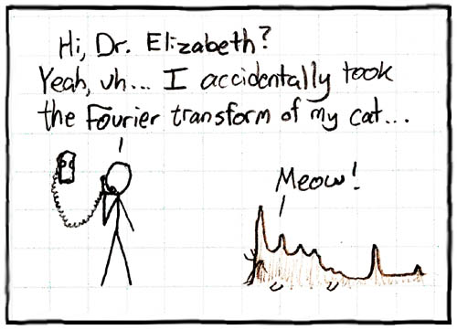
Fourier Analysis Applications
Here are some applications of Fourier Analysis:
Signal Processing
Option Pricing
Number Theory
Statistics / Probability Theory
Harmonic Analysis
Image Processing

Slide 7
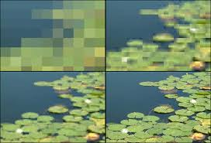
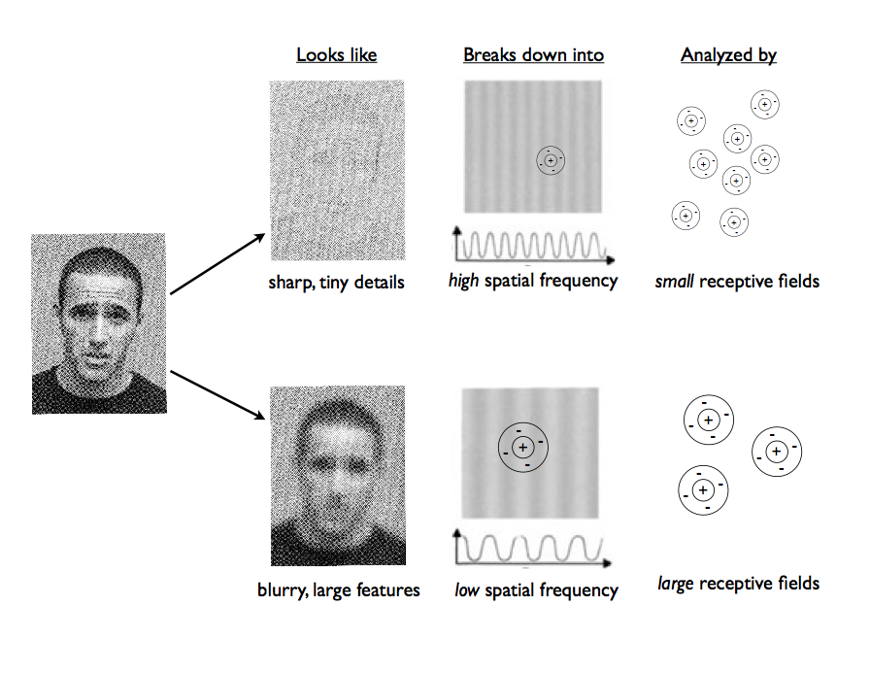
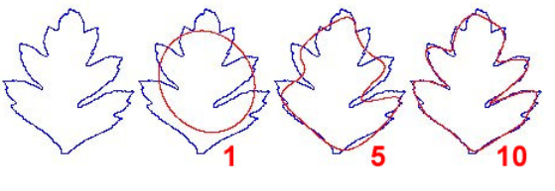
Outline of the leaf at right, summarized using 1, 5, and 10 harmonics (elliptic Fourier analysis carried out using EFAWIN on outline data obtained with TPSDIG; both programs - and many others - can be downloaded from the Morphometrics Website).

Slide 8
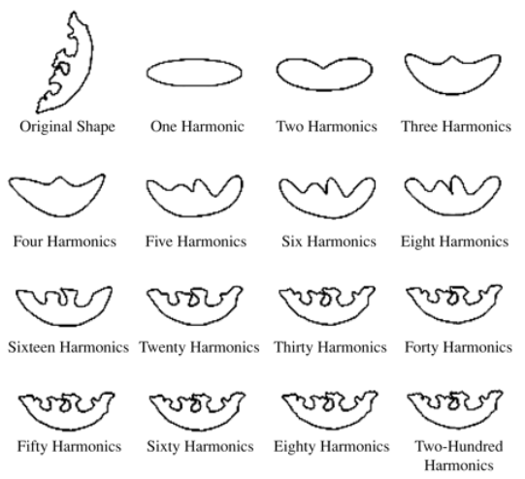
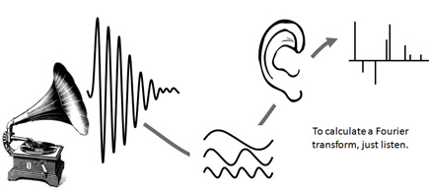
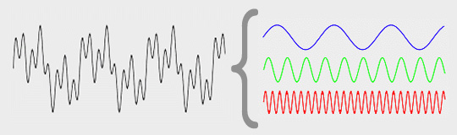
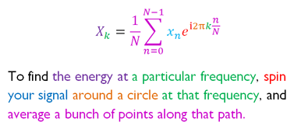
FFTs are useful as a high-pass to remove low-frequency periodic variations (e.g. hourly, daily, weekly) and then you can back-transform to the time domain and use that as input for your monitoring tools.

Slide 9
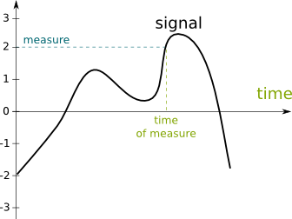
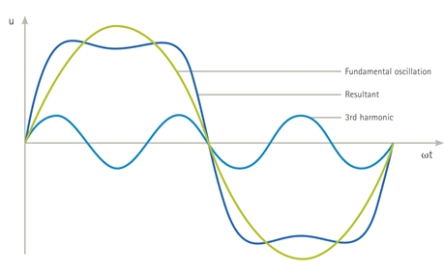
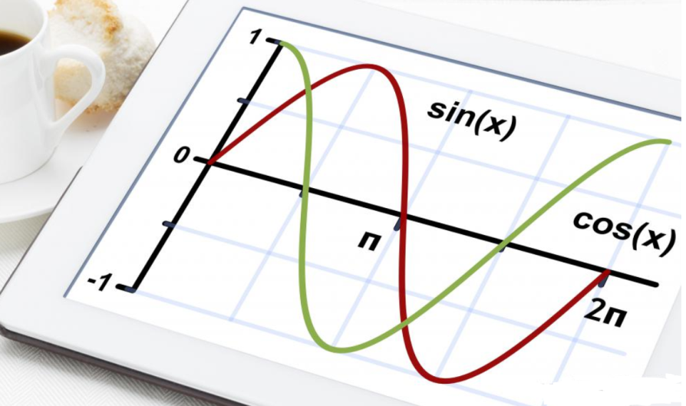
FFTs are useful as a high-pass to remove low-frequency periodic variations (e.g. hourly, daily, weekly) and then you can back-transform to the time domain and use that as input for your monitoring tools.

Slide 10
Practical Example – Knapsack Problem

Slide 11

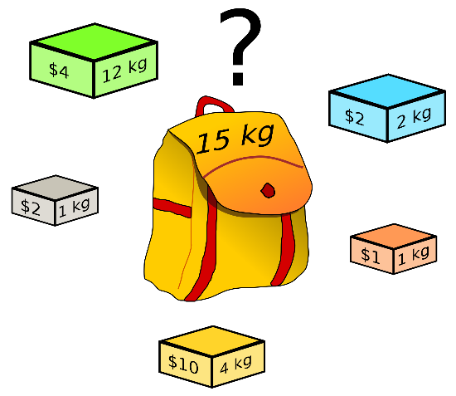
The Knapsack Problem
The knapsack problem can be thought of as the following:
“You are going to spend a month in the wilderness. You’re taking a backpack with you, however, the maximum weight it can carry is 20 kilograms. You have a number of survival items available, each with its own number of “survival points”. You’re objective is to maximize the number of survival points.”
This type of problem is called a constrained optimization problem because we are limited to carrying a maximum weight of 20 kilograms.
Our goal is to devise:
A genetic algorithm to approach solving the knapsack problem.

Slide 12
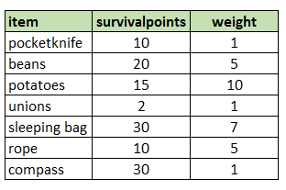
Understanding the data
In order to better prepare the analysis, we must first understand the data we are working with.
There are 7 row entries in our chromosome and a 0 will represent “do not include” and 1 represents “include”.
Therefore, an example of a chromosome would be “1001011”
Each row will be encoded into a chromosome bitstring. A single row represents a single value in the bitstring.

Slide 13
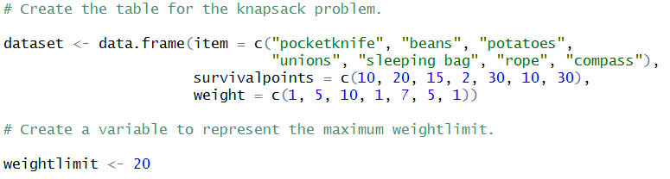
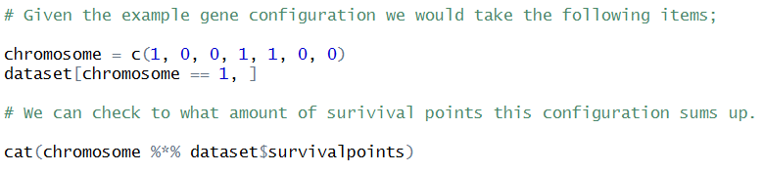
The Knapsack Problem
Here is the code to create the dataset:
This will show us how to create a chromosome to include the first, fourth, and fifth item.

Slide 14
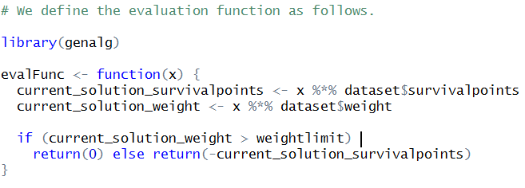
The Knapsack Problem
The genalg algorithm tries to optimize towards the minimum value. Therefore, the value is calculated as above and multiplied with -1.
A configuration which leads to exceeding the weight constraint returns a value of 0 (a higher value can also be given).

Slide 15
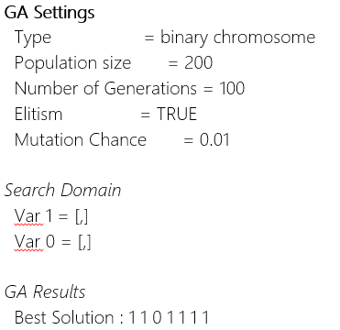
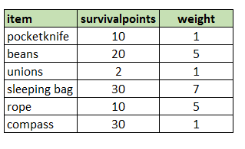
The Knapsack Problem
Next, we choose the number of iterations, design and run the model.
Notice that within the settings of genalg, the type is a binary chromosome by default:
Optimal Knapsack Configuration

Slide 16
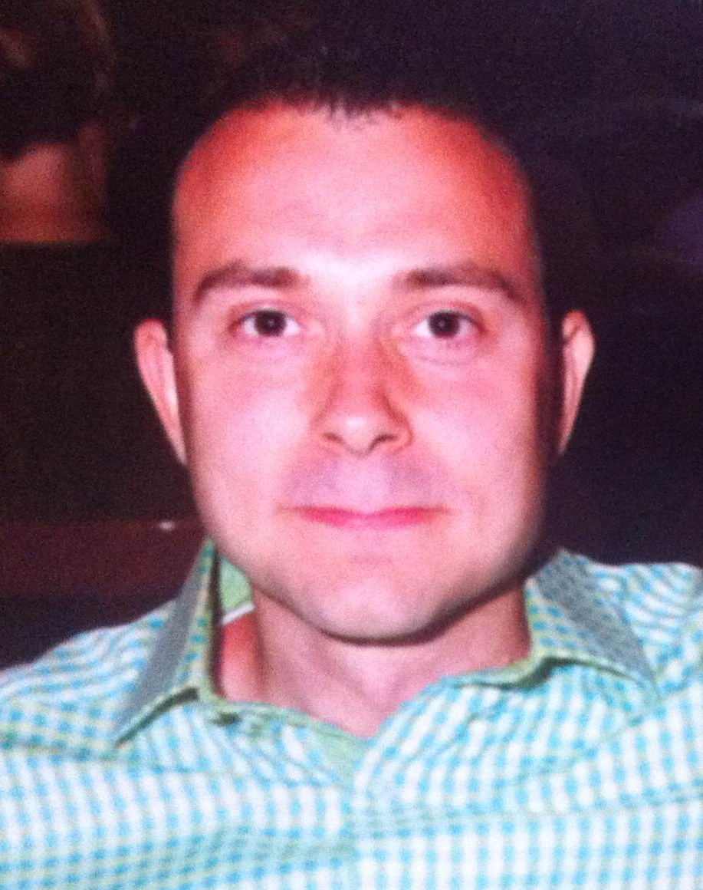
About Me
Reside in Wayne, Illinois
Active Semi-Professional Classical Musician (Bassoon).
Married my wife on 10/10/10 and been together for 10 years.
Pet Yorkshire Terrier / Toy Poodle named Brunzie.
Pet Maine Coons’ named Maximus Power and Nemesis Gul du Cat.
Enjoy Cooking, Hiking, Cycling, Kayaking, and Astronomy.
Self proclaimed Data Nerd and Technology Lover.

Slide 17
Acknowledgements
http://en.wikipedia.org/wiki/Fourier_analysis
http://labs.eeb.utoronto.ca/dickinson/MorphometricMethods.HTML
https://danslimmon.wordpress.com/2014/05/16/wherein-i-rant-about-fourier-analysis/
http://www.wisegeek.com/what-is-a-fourier-analysis.htm
http://www.di.fc.ul.pt/~jpn/r/fourier/fourier.html
http://www.stats.uwo.ca/faculty/aim/tsar/tsar.pdf
http://www.inside-r.org/howto/time-series-analysis-and-order-prediction-r
http://www.r-bloggers.com/fft-fast-fourier-transform-of-time-series-promises-and-pitfalls-towards-trading/
http://www.r-bloggers.com/the-fourier-transform-explained-in-one-sentence/

Slide 18
Fine

